Slide 1
VIRTUAL PRIVATE NETWORKS

Slide 2
INTRODUCTION
A Virtual Private Network is a connectivity object between two or more private entities.
It uses the Internet or public domain infrastructure and connects private networks.
Allows to create secure private network over public network.
Usually between geographically separate locations.

Slide 3
INTRODUCTION
Instead of dialing into a central RAS point. the users dials into regional internet service provider and connects to private network via some secure protocol ( i.e. SSL,PPTP,L2TP etc )

Slide 4
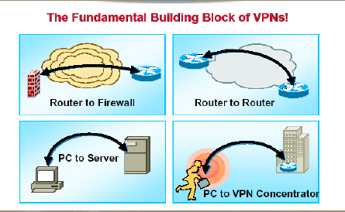

Slide 5
Types of VPN
VPN is divided in two types:
  Remote-Access
  Site-to-Site

Slide 6
Types of VPN.......
Remote-Access
  The typical example of this is a dial-up connection from home or for a mobile worker, who needs to connect to secure materials remotely.

Slide 7
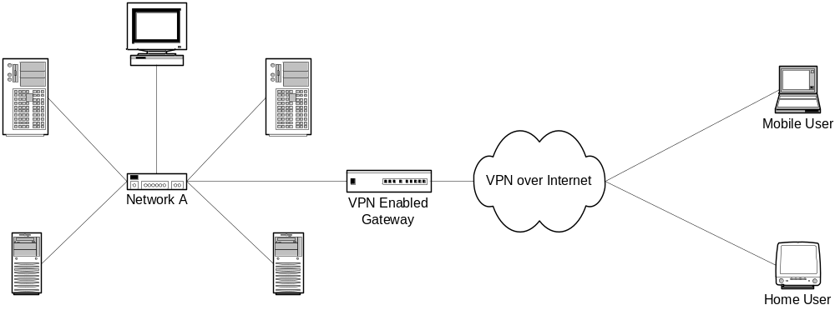
Remote-Access Example

Slide 8
Types of VPN……
Site-to-Site
  The typical example of this is a company that has offices in two different geographical locations, and wants to have a secure network connection between them.

Slide 9
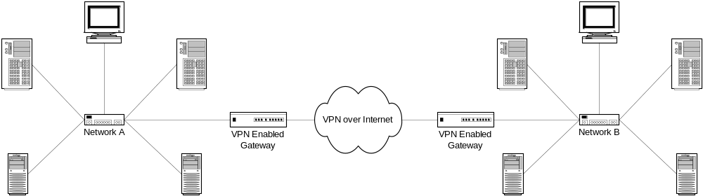
Site-to-Site Example

Slide 10
VPN ARCHITECTURE

Slide 11
VPN ARCHITECTURES
Client Initiated VPN’s
NAS Initiated VPN’s

Slide 12
CLIENT INITIATED VPN’S
Users establish a tunnel across the ISP shared network to the customer network.
The customer manages the client software that initiates the tunnel.
Advantage : They secure the connection between the client and ISP.
Disadvantage : Not as scalable and are more complex than NAS initiated VPN’s

Slide 13
NAS INITIATED VPN’S
Users dial in to ISP NAS which establishes a tunnel to private network.
NAS Initiated VPN’s are more robust than client initiated VPN’s to maintain tunnel creating software.
NAS initiated VPN’s do not encrypt the message between the client and ISP, but this is not a concern for most customers as PSTN is much more secure than internet.

Slide 14
VPN HARDWARE TERMINOLOGY

Slide 15
NETWORK ACCESS SERVER
Fundamentally two routers are needed for a VPN.
Network Access Server
  It receives incoming calls for dial in VPN’s and places outgoing calls for dial out VPN’s.
  Typically it is maintained by ISP that wishes to provide VPN services to its customers.

Slide 16
TUNNEL SERVER
Tunnel Server
  It terminates dial in VPNs and initiates dial out VPNs.
  Typically it is maintained by ISP customer ,and is the contact point for customer network.

Slide 17
DIAL IN AND DIAL OUT
In dial in scenarios, users dial into NAS, and NAS forwards the call to tunnel server using a VPN tunnel.
In dial out scenarios, the tunnel server initiates a VPN tunnel to NAS,and NAS dials out to the clients.

Slide 18
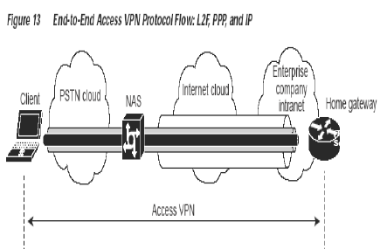

Slide 19
BENEFITS OF VPN TECHNOLOGY

Slide 20
OUTSOURCING THE RESPONSIBILITY
The customer outsources the responsibility for the information technology infrastructure to ISP that maintains the modems the remote users dial in to ,access servers and internetworking expertise.
The customer is then only responsible for authenticating the users and maintaining its network.

Slide 21
SAVING THE PENNIES
Instead of connecting directly to the network using the expensive PSTN, access VPN users only need to use PSTN to connect to ISP local point of presence.
The ISP then uses the internet to forward the users from the POP to customer network.
Forwarding a user call over the internet provides dramatic cost saving for the customers.

Slide 22
MULTI PROTOCOL SUPPORT
VPNs allow separate and autonomous protocol domains to share common domain infrastructure including modems, access servers, ISDN routers.
VPNs uses following tunneling protocols
  Layer 2 Forwarding
  Layer 2 Tunneling Protocol
  Point to point tunneling protocol

Slide 23
SECURITY
Authentication
Encryption
Tunneling
Firewalls

Slide 24
Tunneling
Tunneling can be defined as a way to transfer data between two similar networks Over an intermediate network.
Tunneling encloses one type of data packet into the packet of another Protocol
Before this encapsulation takes place, the packets are encrypted so that the data Is unreadable to anyone monitoring the network.
At the destination, these packets are separated and returned to their original Format

Slide 25
All the tunneling protocols operate by Tunneling Layer 2 of the OSI Reference Model for communications protocols.
PPP is commonly used to transport IP and other protocols over serial and digital connections.
Typically PPP connections are made between a client and remote host, such as remote access server.

Slide 26
Tunneling generally involves three different protocols:
Carrier protocol: This is the protocol used by the network that the information is Traveling over, usually TCP/IP
Encapsulating protocol: This is the protocol that the original data is packaged in, Like IPSEC,PPTP,orL2TP.
Passenger Protocol: The original or native data is being carried from the network Where the originating host resides like IPX, APPLETALK, or IP

Slide 27
Generally based on two types of protocols:
Layer 2 Tunneling protocols
Correspond to the Data link layer
ex: PPTP,L2TP and L2F
Encapsulates the data in a Point-to-Point Protocol (PPP)
frame.
Layer 3 Tunneling protocols
Correspond to the Network layer and use Packets.
ex: IP over IP, IP Security (IPSec) Tunneling mode.

Slide 28
Layer 2 Tunneling protocol characteristics:
  The tunnel endpoints must first agree to the communications
session as well as to any necessary configuration variables,
like encryption, assignment of addresses and compression.
  Layer 2 Protocols are based on the well defined PPP
protocol .
Some of the features of these Protocols are:
    USER AUTHENTICATION
    DATA COMPRESSION
    DATA ENCRYPTION
    KEY MANAGEMENT

Slide 29
Layer 2-Tunneling Protocol:
L2TP is based upon the best features of PPTP and L2F.
L2TP extends the PPP session "virtually" across an IP network where it terminates at a network access server (NAS). The NAS is usually at the corporate network site to which the remote user wishes to connect.
PPTP, L2F and L2TP do not include encryption mechanisms in their specs. Encryption has to be provided on top of the protocol.

